Slide 1

Embracing Data Science Navigating Risk Aversion in Traditional Organizations
Christos Sarakinos Joint Statistical Meetings 2023-08-03

Slide 2

Intro & Caveats

Slide 3



Presenter Context: The Data Science and Innovation Division at StatCan
Solution Delivery
Information Extraction
Text Analytics
Image Analytics & Applied AI
Capacity Development & Analytical Diversification
Partnerships & Operations Management
Competencies & Recruitment
Surge Team
Methods, Quality & Research
Model Quality & Validation
Responsible Machine Learning
Privacy Enhancing Technologies

Slide 4
The Usual Caveats
This presentation:
Is extremely specific to presenter context
i.e. YMMV.
Reflects the personal opinions of the presenter
i.e. Does not reflect the views of Statistics Canada.
Offers no definitive conclusions
i.e. Describes a work in progress.

Slide 5

Context

Slide 6




Declining response rates
Data collection has grown to include the delivery of 450 surveys, yet there has been a steady decline in response rates, increasing the cost of data collection.
A deluge of data
Data varieties, volumes and velocities have been increasing. This presents a potential solution to declining response rates, as well as its own set of challenges. New capabilities are required.
National Statistics Office
Heightened expectations
The confluence of online platforms and fast capitalism has ushered in a culture of immediacy. Canadians have higher expectations of government than ever before.
Potential private sector “insights”
Big tech holds troves of personal data that could produce insights. Despite unclear commitment to rigour and social good there is a danger that these could be considered “good enough.”

Slide 7

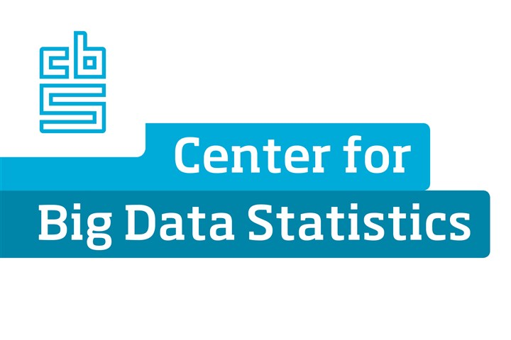


Western democracies have invested heavily in data science, developing capabilities in response to these drivers.
Data Science promises to increase relevance and drive operational excellence.
But…

Slide 8

Risk…

Slide 9
Data Science requires changes across multiple areas – which introduces new risks
Cybersecurity
Reputational
Methodology
IT Development
IT Solution Maintenance
Privacy
Project Management

Slide 10
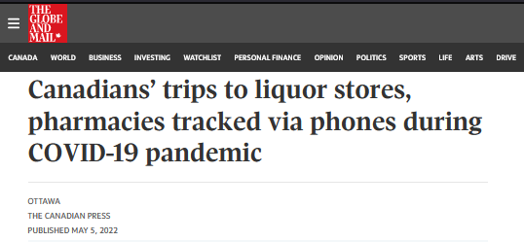
Privacy

Slide 11

Methodology

Slide 12
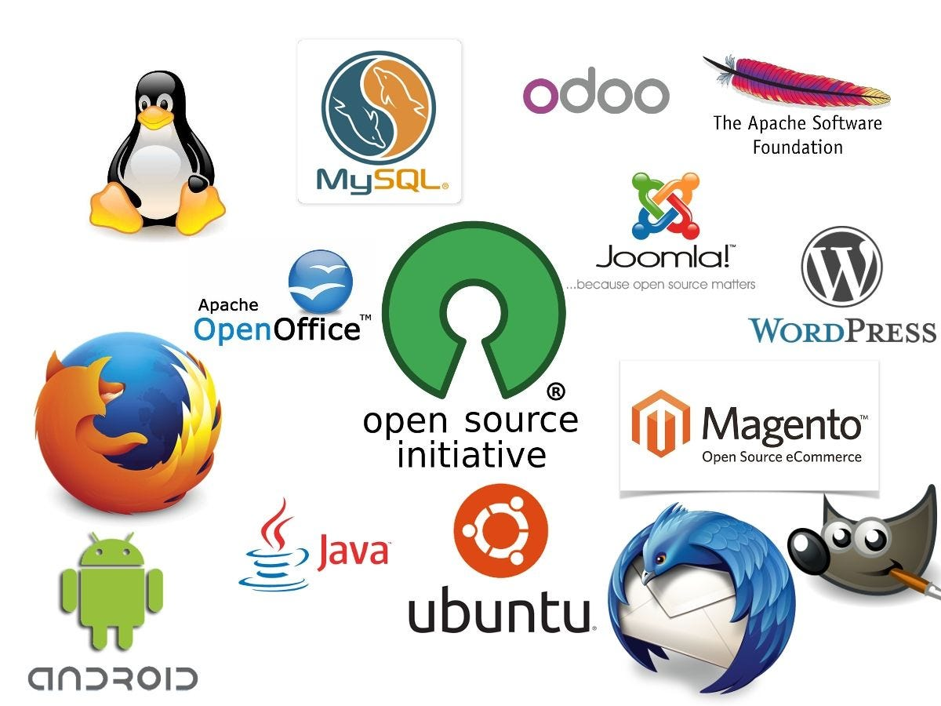
Cybersecurity

Slide 13
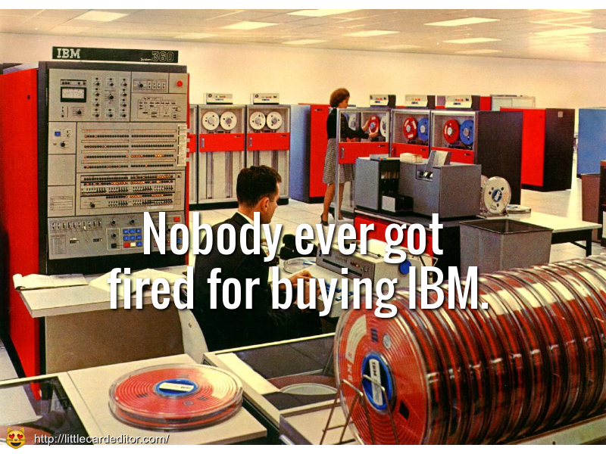
Reputational

Slide 14
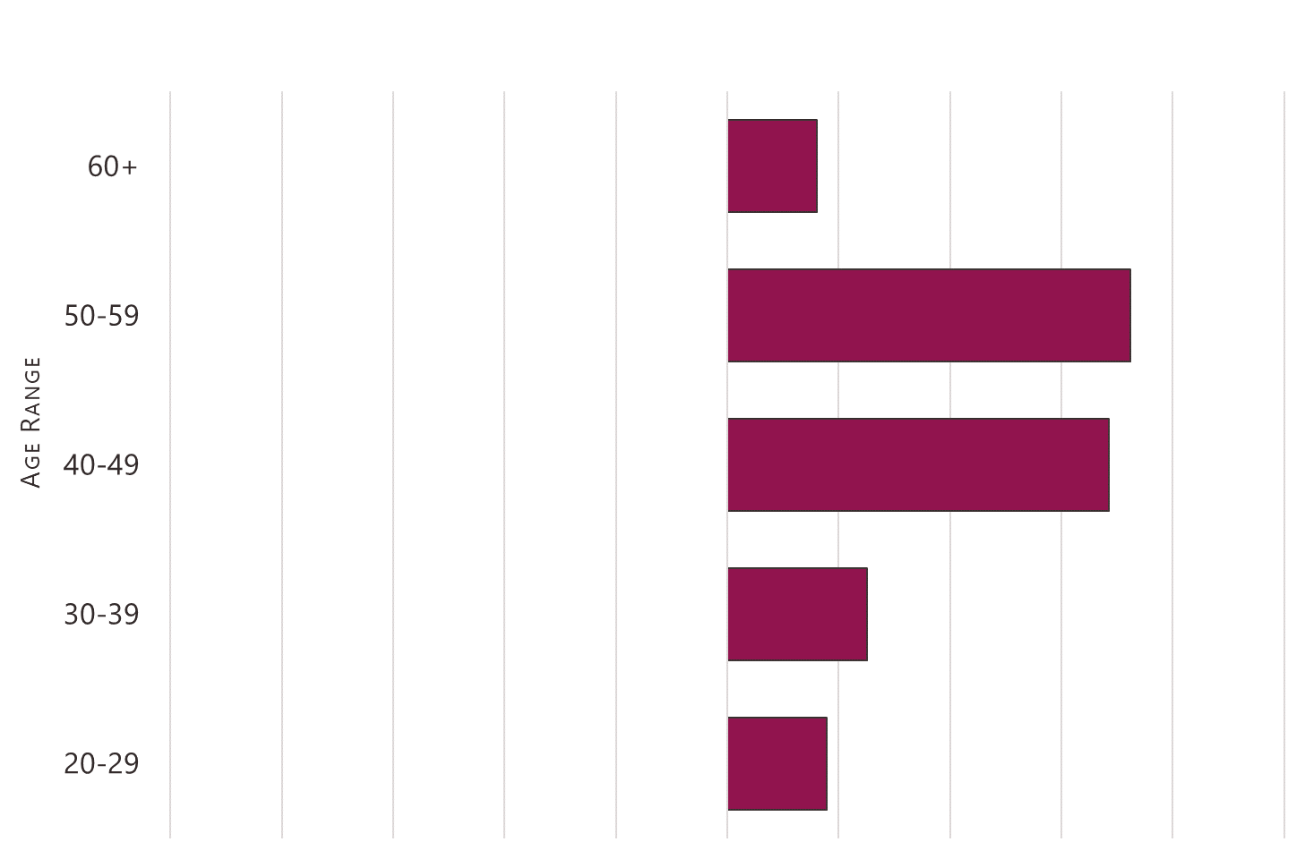









IT Development

Slide 15
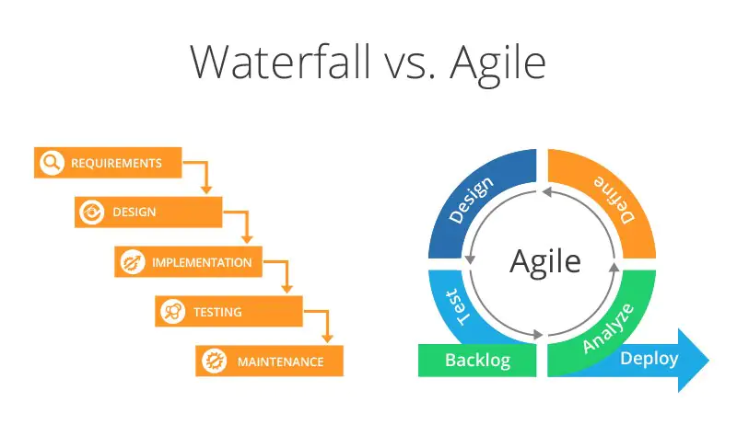
Project Management

Slide 16
IT Solution Lifecycle
Expert Data Scientist
Modern Analyst
Typically has advanced degrees in mathematics, statistics or data science.
Often part of a centralized data science team (though not necessarily).
Has advanced technical skills and can write code to create algorithms and analytical models.
Handles complex analytics applications that involve large data sets and advanced analysis.
Usually little to no formal data science training, but rather BI or business analysis background.
Commonly part of a business unit, with domain-specific knowledge of issues and information needs
Tend to rely on augmented analytics and automated tools with drag-and-drop
Some advanced analysis, possibly in collaboration with expert data scientists.
Notes:
Data Science Division, Consumer Prices and Agricultural Statistics have expert data scientists.
Expert data science capability also grew across other program areas, including International Accounts, Retail and Service Industries, Tourism and Transportation, Investment in Science and Technology, the Centre for Special Business Products, Census Operations, Social Statistics Methods, and Statistical Integration Methods.

Slide 17

Culture

Slide 18
Competing Values Framework
Flexibility
do things together
do new things
Clan Culture
Adhocracy Culture
Internal
External
Hierarchical Culture
Market Culture
do things right
do things fast
Stability

Slide 19
A Hierarchical Culture
Flexibility
do things together
do new things
*
Internal
External
do things right
do things fast
Stability

Slide 20
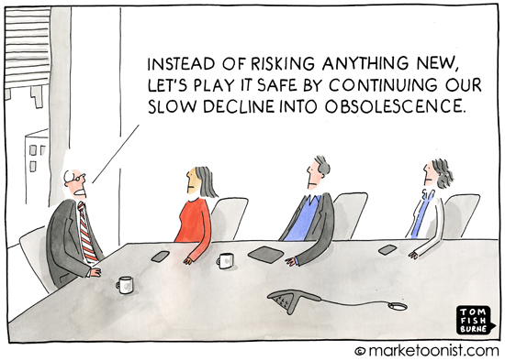

Slide 21
Stage One Ad hoc
Stage Two Foundational
Stage Three Integrated
Stage Four Cultural
Data Science Maturity
Data science is pervasive
Integrated into org. processes
Quality governance
Infrastructure optimized
Full organizational support
Stable funding for the hub
Strategy implemented
Critical mass of centralized expertise
Projects cross bus. units
Beginnings of production
Infrastructure development
Strategy developed
Dedicated team
Proofs of concept
Minimal org. support
No strategy
Isolated efforts
Ad hoc exploration

Slide 22

Strengthening Organizational Capacity for Change

Slide 23



Strengthening Org. Capacity for Change
1. Programs for Building Capacity | 2. Governance to Foster Innovation | 3. Integrated Quality Management

Slide 24




1. Programs for Building Capacity
 | Talent Acquisition and Mobility | Hiring Strategies: DS Post-Secondary Recruitment Campaign; Central student hiring campaign Mobility and reskilling initiatives: Exchanges, Recruit Dev.
 | Qualifications and Competencies | Professional standards: work descriptions, taxonomies Competency mapping: identify streams and talent segments, aligned with frameworks
 | Talent Development | Strategies: Learning roadmaps and job aids Partnerships: co-delivered training and reskilling
 | Retention and Engagement | Skills analysis: demands map; gap analysis Succession planning and recognition

Slide 25


2. Governance to Foster Innovation
Enterprise-Level Governance of Solutions
Community Governance of Data Science Policies

Slide 26
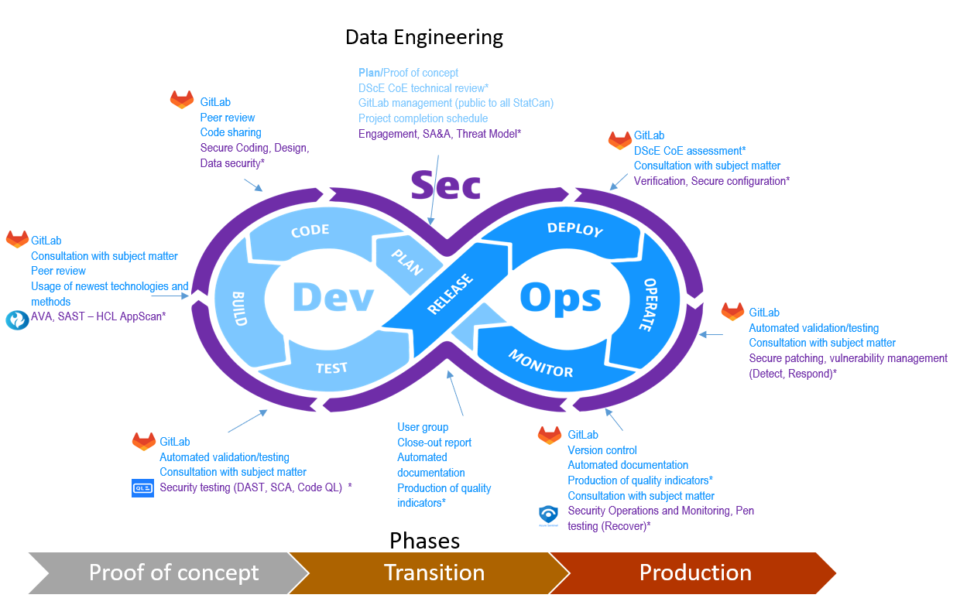
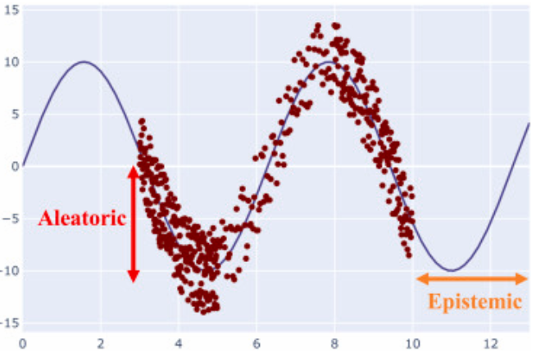
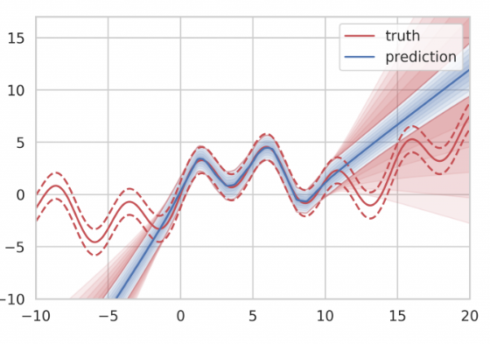
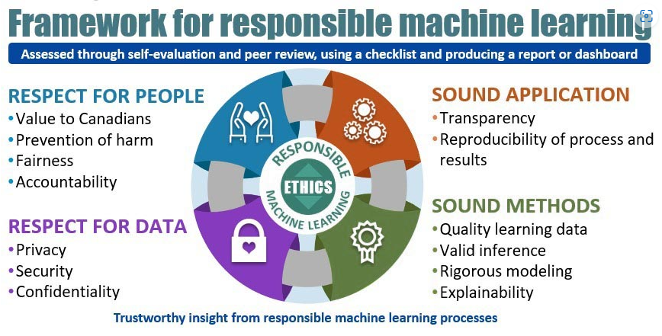
3. Integrated Quality Management
Quality Assurance Steps
Proof of concept plan
Security authorization
Technical review
GitLab
Project completion schedule
Code sharing
Code review
Consultation with subject matter
Best technologies and methods
Threat review
Automated validation /testing
Automated documentation
Value assessment
Security testing and code review
Production of quality indicators
Close-out report
Notes:
Efforts underway to develop machine learning quality dimensions.
To encompass explainability and interpretability; fairness; robustness and reliability; accuracy and uncertainty quantification; confidentiality and privacy.
Some initiatives underway:
Uncertainty Quantification (UQ) for ML validation and prediction
Research in measuring prediction accuracy of for finite population totals
Framework for Advance Indicators (Flash estimates)
Model Explainability and Accuracy (including uncertainty), building on previous Quality Framework for Statistical Algorithms

Slide 27

A Work in Progress

Slide 28
Embracing Data Science Navigating Risk Aversion in Traditional Organizations
Christos Sarakinos Joint Statistical Meetings 2023-08-03

